Slide 1
Classroom slides - performance

Slide 2
Execution time = Number of instructions executed * CPIAvg * clock cycle time
Total execution time: This metric is the cumulative total of the execution times of the individual programs
Arithmetic mean: This metric may bias the summary value towards a time-consuming benchmark program (e.g. P1 = 100; P2 = 1; AM = 50.5).
Geometric mean: This metric removes the bias present in arithmetic mean (e.g. P1 = 100; P2 = 1; GM = 10).
Weighted arithmetic mean: This metric takes into account the relative frequency of execution of the programs in the benchmark mix (e.g. P1 = 100; P2 = 1; fP1 = 0.1; fP2 = 0.9; WAM = 5.45).

Slide 3
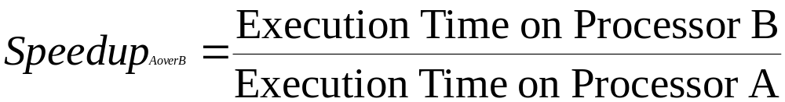
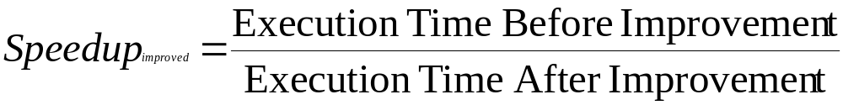
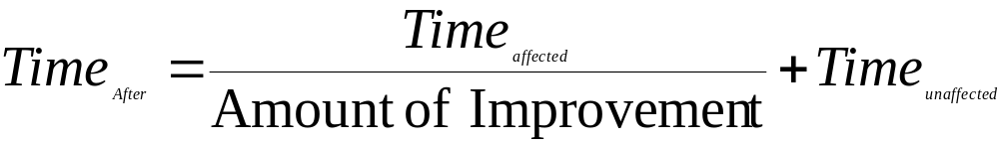
old execution time – new execution time
Improvement in execution time = ----------------------------------------------------
old execution time
Amdahl’s law

Slide 4
An architecture has three types of instructions that have the following CPI:
Type CPI
A 2
B 5
C 1
An architect determines that he can reduce the CPI for B to 3, with no change to the CPIs of the other two instruction types, but with an increase in the clock speed of the processor. What is the maximum permissible increase in clock cycle time that will make this architectural change still worthwhile? Assume that all the workloads that execute on this processor use 30% of A, 10% of B, and 60% of C types of instructions.

Slide 5
Instruction CPI
Add 2
Shift 3
Others 2
Add/Shift 4
If the sequence ADD followed by SHIFT appears in 20% of the dynamic frequency of a program, what is the speedup of the of the program with all {ADD, SHIFT} replaced by the new instruction?
[Hint: a) For every 10 instructions in the original program, 2 instructions are the ADD/SHIFT combo. b) The number of instructions in the new program shrinks to 90% of the original program.]

Slide 6
A processor spends 20% of its time on
add instructions. An engineer proposes to
improve the add instruction by 4 times.
What is the speedup achieved because
of the modification?

Slide 7
Name | Notation | Units | Comment
Memory footprint | - | Bytes | Total space occupied by the program in memory
Execution time | (∑ CPI_{j}) * clock cycle time, where 1 ≤ j ≤ n | Seconds | Running time of the program that executes n instructions
Arithmetic mean | (E₁+E₂+…+E_{p})/p | Seconds | Average of execution times of constituent p benchmark programs
Weighted Arithmetic mean | (f₁*E₁+f₂*E₂+…+f_{p}*E_{p}) | Seconds | Weighted average of execution times of constituent p benchmark programs
Geometric mean | p^{th} root (E₁*E₂* …*E_{p)} | Seconds | p^{th} root of the product of execution times of p programs that constitute the benchmark
Static instruction frequency |  | % | Occurrence of instruction i in compiled code
Dynamic instruction frequency |  | % | Occurrence of instruction i in executed code
Speedup (M_{A} over M_{B}) | E_{B}/E_{A} | Number | Speedup of Machine A over B
Speedup (improvement) | E_{Before}/E_{After} | Number | Speedup After improvement
Improvement in Exec time | (E_{old}-E_{new})/E_{old} | Number | New Vs. old
Amdahl’s law | Time_{after} = Time_{unaffected} + Time_{affected}/x | Seconds | x is amount of improvement

